Slide 1
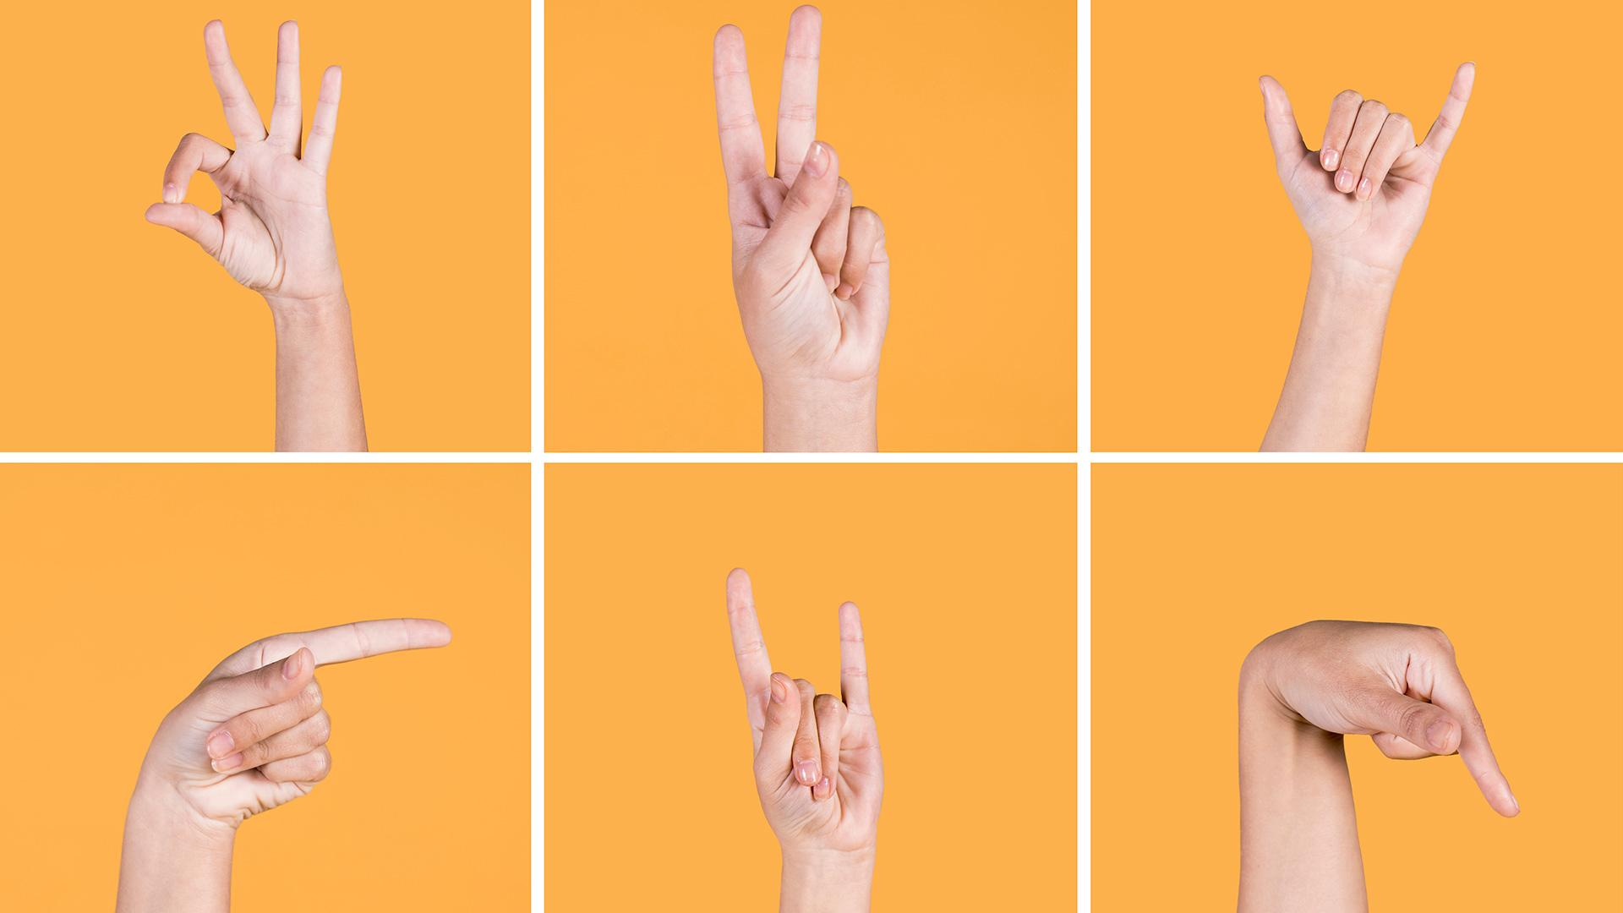
SIGN LANGUAGE
Eng. Musa Ghazwani
Abdulaziz Abuhaimed
supervised by
Mohamed Al Moghalis

Slide 2

Table of Containt
Introduction
Goals
Workflow
Tools
Data
Data Preprocess
Model
Test in Real Time
Challenges
Future Work

Slide 3
INTRODUCTION & Goals
Train an LSTM
Extract holistic Keypionts
Real time sign language detection

Slide 4
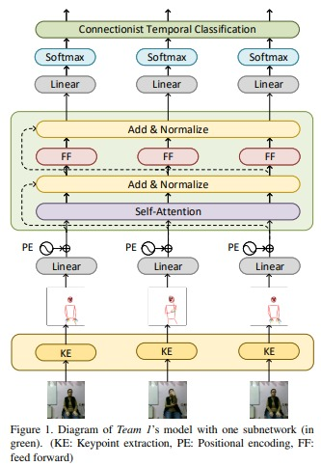
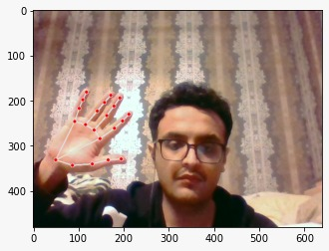
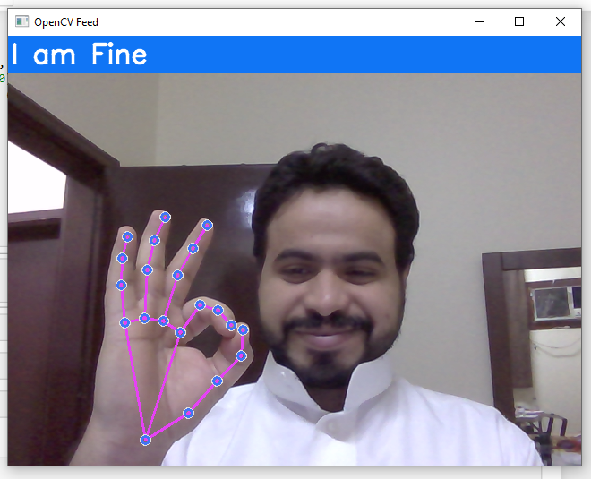
Workflow
Extract Key-point
Train Model
OpenCV
Step 1
Step 2
Step 3

Slide 5





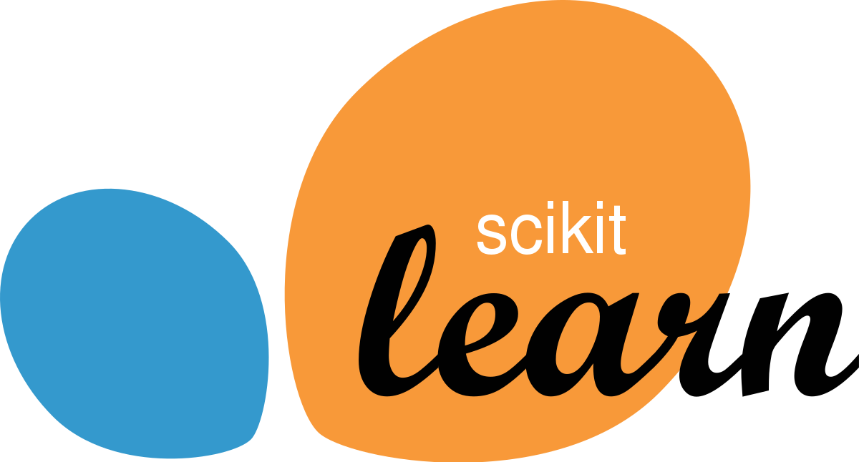
Tools

Slide 6
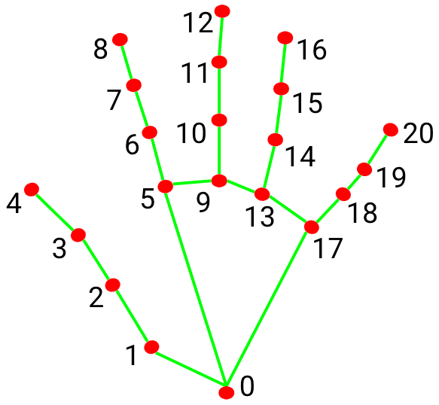

Data
we collected 30 video per action then each one of those video sequences are going to contain 30 frame of data each frame will contain 126 landmark value

Slide 7

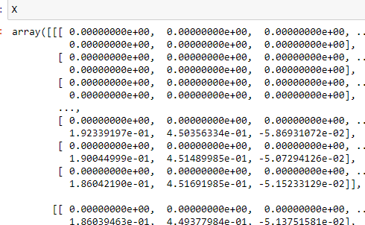
Data Preprocess
Create Dictionary
Store sequence inside a numpy array
preformed training and testing partition

Slide 8
Model
LSTM Model is trained using the extracted key-points and later used for real time predictions
we chose this model because Mediapipe Holistic with LSTM Model gives much better accuracy.

Slide 9

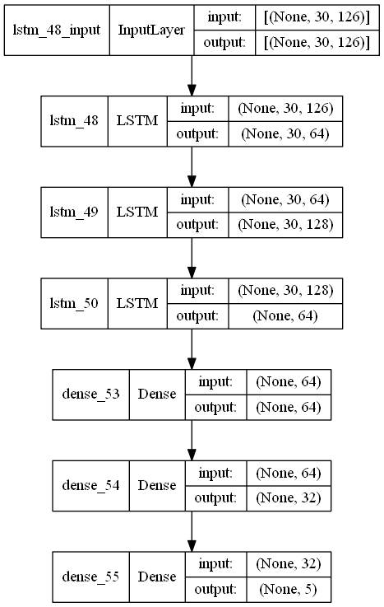
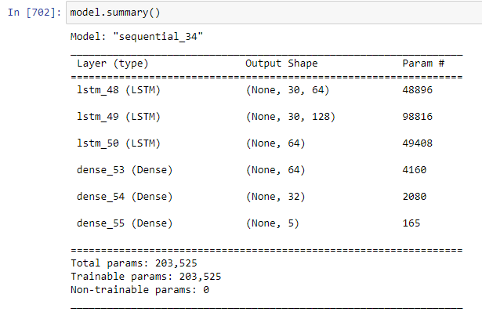

LSTM

Slide 10

Test in Real Time

Slide 11
Challenges
01
02
03
Dataset
libraries
Time

Slide 12
Future Work
Moor sign language
Voice
Arabic
Reverse

Slide 13
THANKS

